Slide 1
HCV treatment with direct-acting antivirals (DAAs) in HIV/HCV coinfected subjects affects the dynamics of the HIV-1 reservoir
Y. Ghiglione¹, M.L. Polo¹, A. Solomon², G. Poblete³, M.J. Rolón³, P. Patterson⁴, H. Pérez³, H. Salomón¹, F. Quiroga¹, G. Turk¹, S.R. Lewin^{2,5}, N. Laufer¹
¹INBIRS Institute (UBA-CONICET), Buenos Aires, Argentina, ²The University of Melbourne, Peter Doherty Institute, Melbourne, Australia, ³Hospital Fernández, Infectious Diseases Unit, Buenos Aires, Argentina, ⁴Huésped Foundation, Buenos Aires, Argentina, ⁵Alfred Health and Monash University, Department of Infectious Diseases, Melbourne, Australia

Slide 2
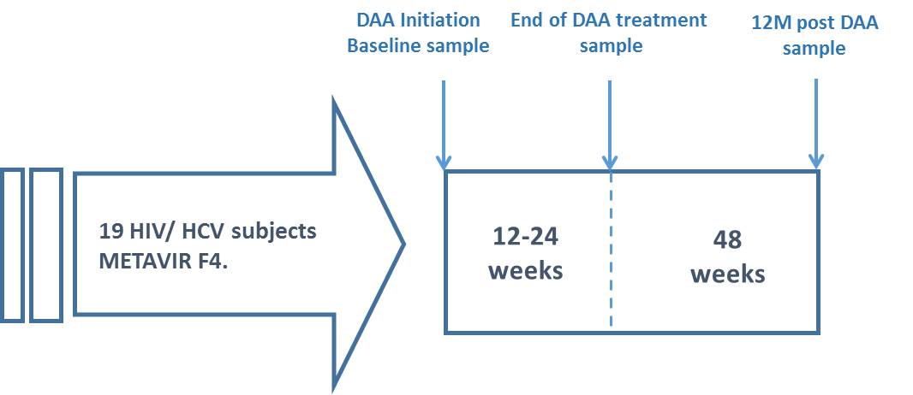
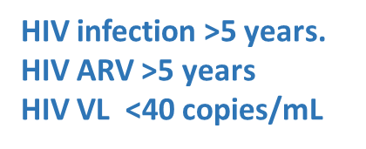
The effect DAA for HCV on the HIV reservoir in co-infected individuals is not completely understood.
Hypothesis: HCV cure would reduce persistent IFN signaling and would have downstream effects on the frequency of infected cells and their basal transcriptional activity.

Slide 3
Results: immunological reconstitution

Slide 4
Results: HIV reservoirs
** p <0.01
ns p >0.05

Slide 5
CONCLUSIONS
Higher levels of HIV US-RNA in HCV/HIV⁺ than HIV⁺
Even higher after DAAs HCV clearance.
HCV clearance, or related downstream effects impact HIV persistence on ART.
These changes are consistent with increased basal transcription in latently infected cells post-HCV clearance which could be secondary to reduction in chronic IFN signaling.

